Slide 1

Sql project Imbd dataset
DA/DS, Reinforcement Project (Advanced SQL)
KGISL micro college
BY
Mohammed Suhail M R

Slide 2
Introduction
The dataset provided is a simplified version of the IMDb database, structured to capture essential information about movies, their genres, actors, directors, ratings, and more. This database consists of several tables that contain various details such as Movie, Genre, Director Mapping, Role Mapping, Names, Rating.
Reinforce key SQL concepts such as joins, aggregation, filtering, and grouping.
Analyse and extract meaningful insights from a real-world movie dataset.
Document, present, and improve communication skills by creating a detailed report and a presentation of findings.

Slide 3
Tables description
Movie: Contains basic information about each movie, including title, release year, duration, country, income, languages, and production companies.
Genre: Describes the genres associated with each movie.
Director Mapping: Maps movies to their directors.
Role Mapping: Maps actors/actresses to movies and specifies the role category (e.g., actor, director, producer).
Names: Stores information about people (actors, directors, etc.), including their birthdates, heights, and known movies.
Ratings: Contains ratings information for movies, including the average rating, total votes, and median rating.

Slide 4
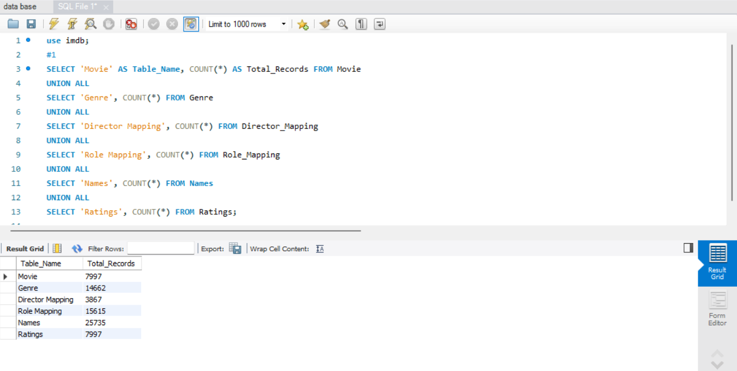
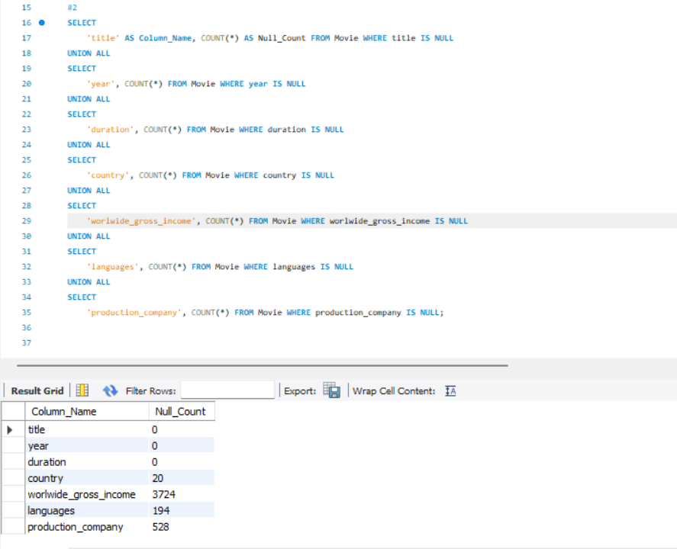
Queries to be Performed 1. Count the total number of records in each table of the database. 2. Identify which columns in the movie table contain null values.

Slide 5
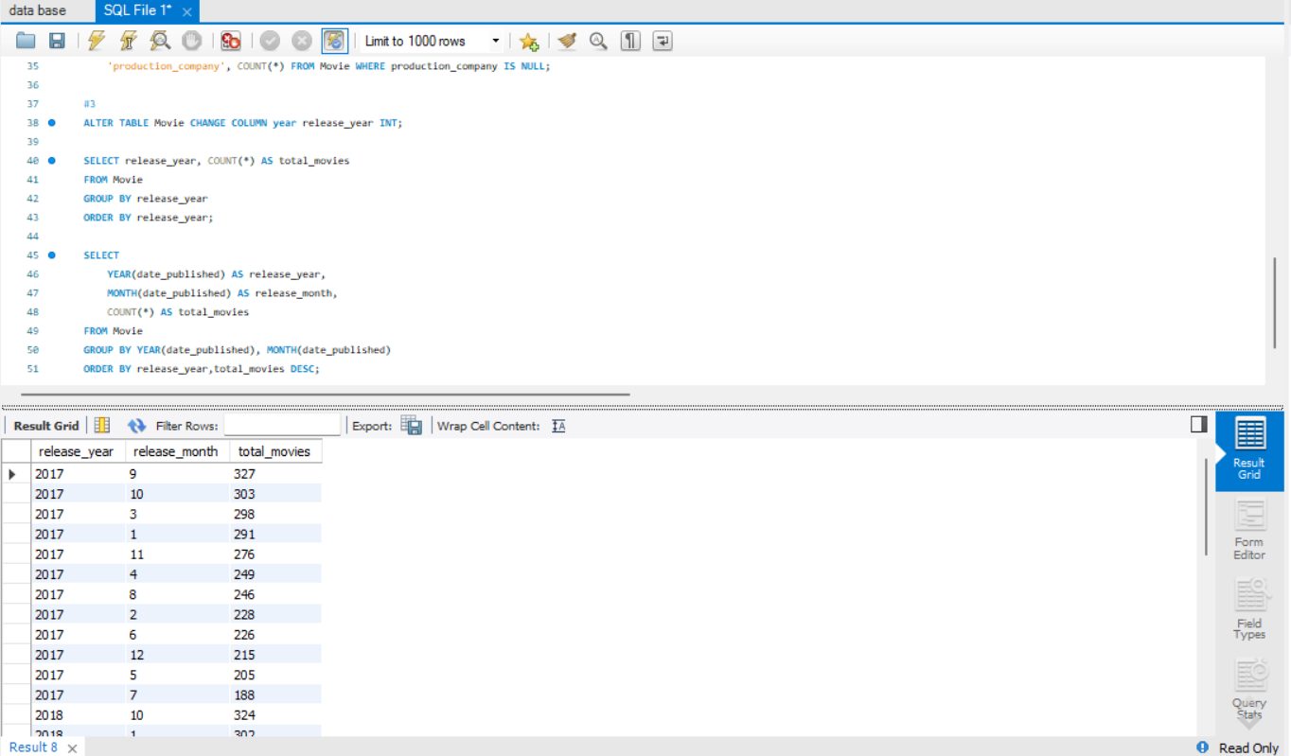
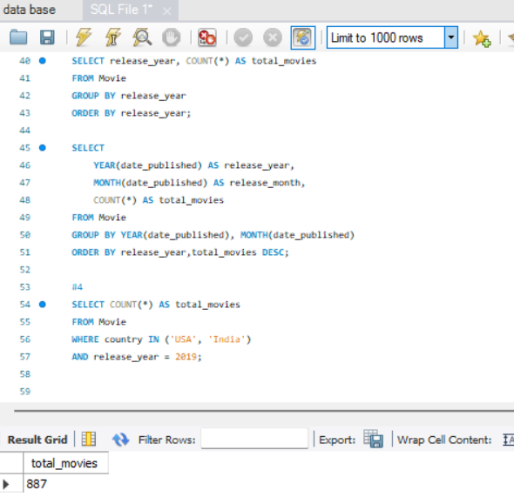
3. Determine the total number of movies released each year, and analyse how the trend changes month-wise. 4. How many movies were produced in either the USA or India in the year 2019?

Slide 6
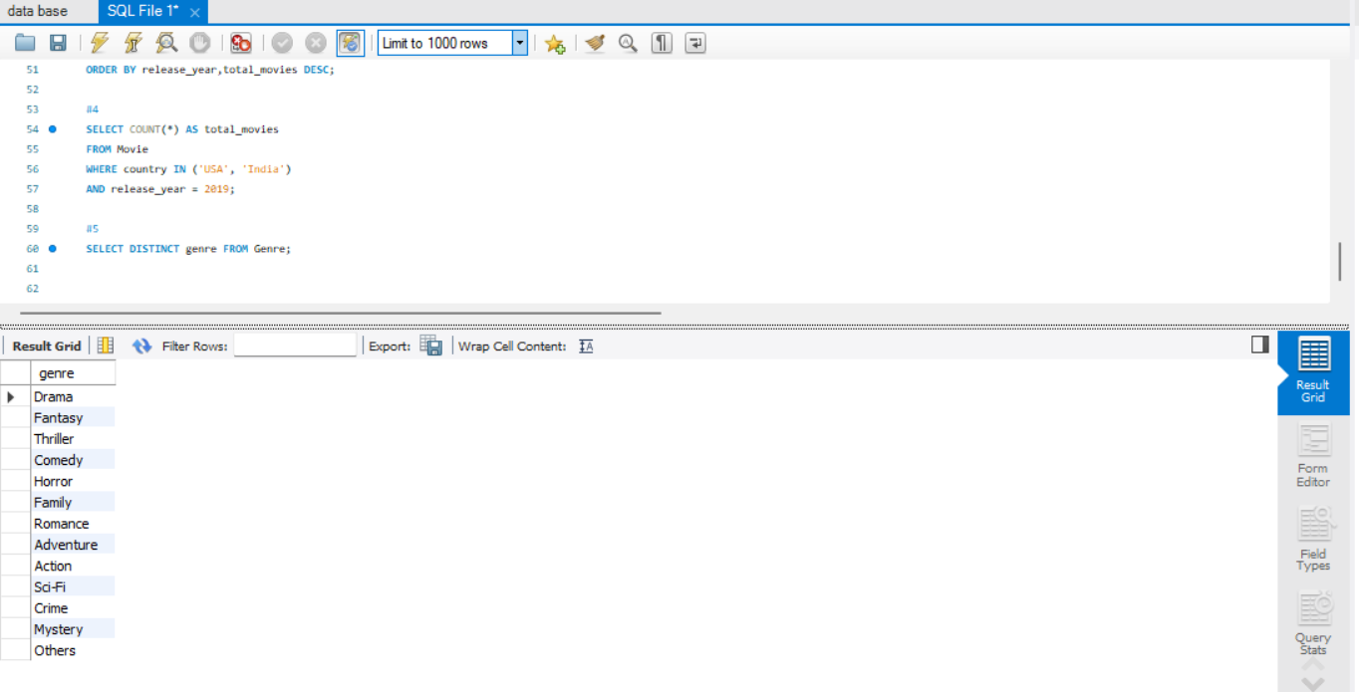
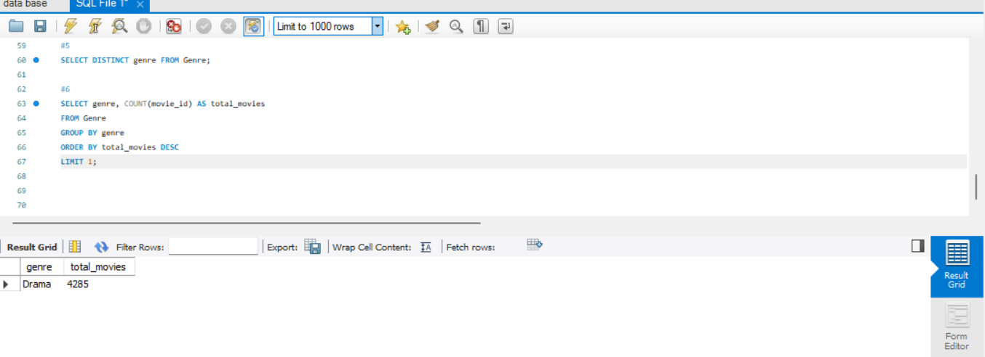
5. List the unique genres in the dataset, and count how many movies belong exclusively to one genre. 6. Which genre has the highest total number of movies produced?

Slide 7
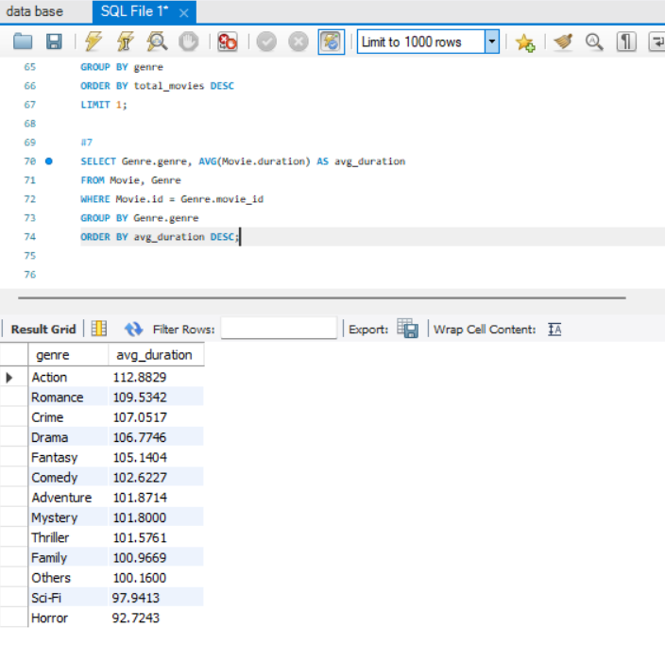
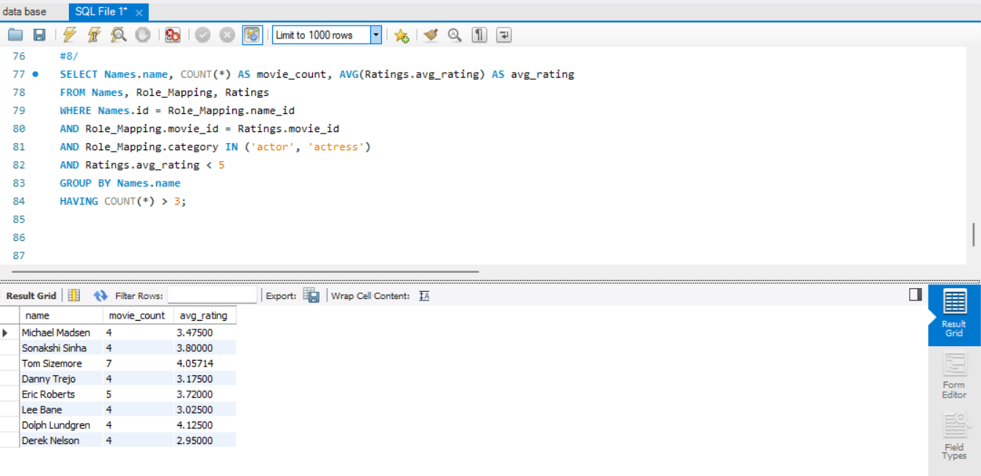
7. Calculate the average movie duration for each genre. 8. Identify actors or actresses who have appeared in more than three movies with an average rating below 5.

Slide 8
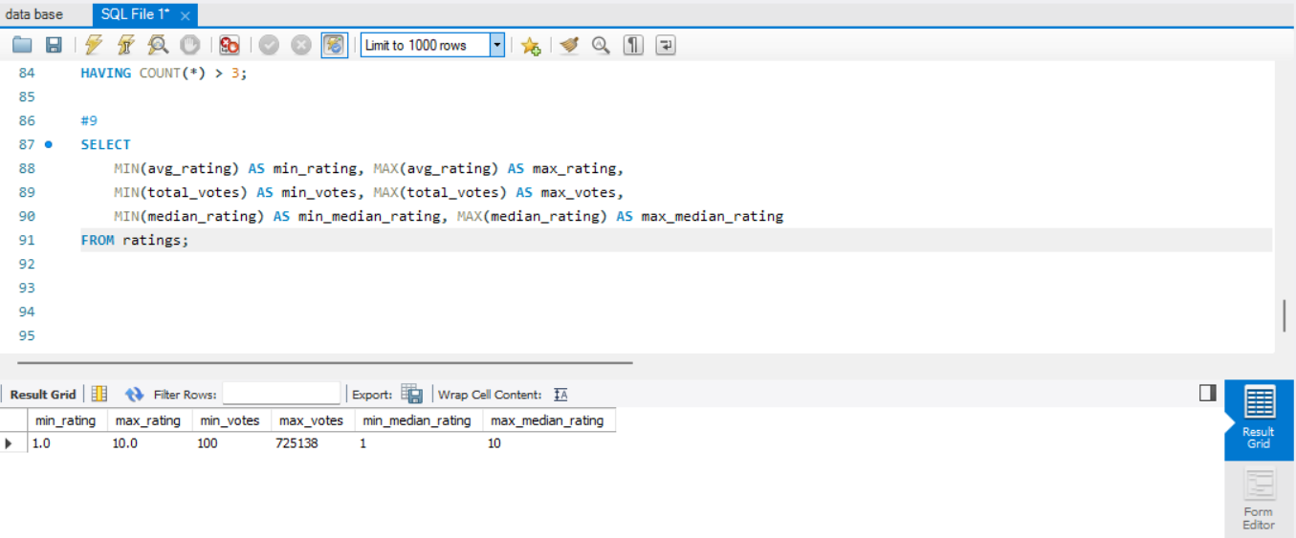
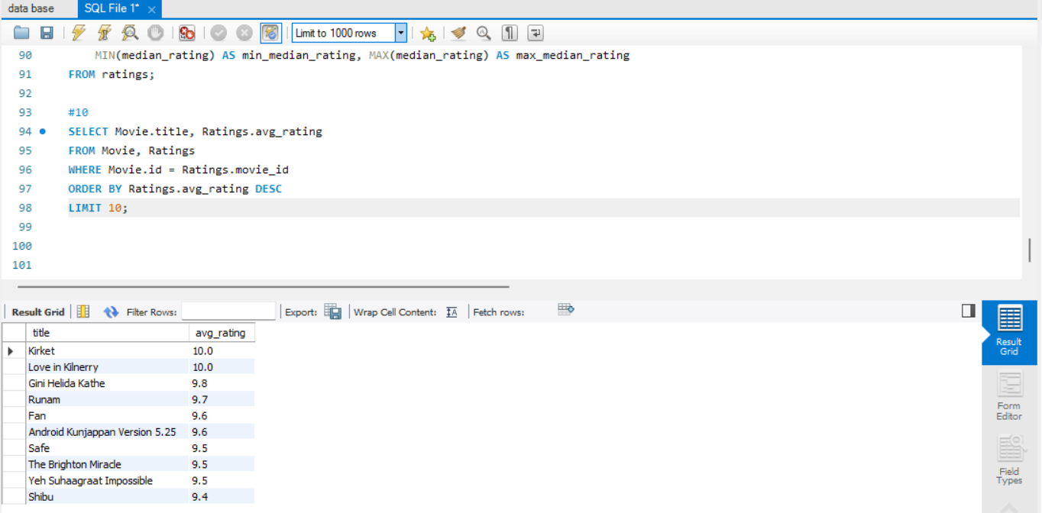
9. Find the minimum and maximum values for each column in the ratings table, excluding the movie_id column. 10. Which are the top 10 movies based on their average rating?

Slide 9
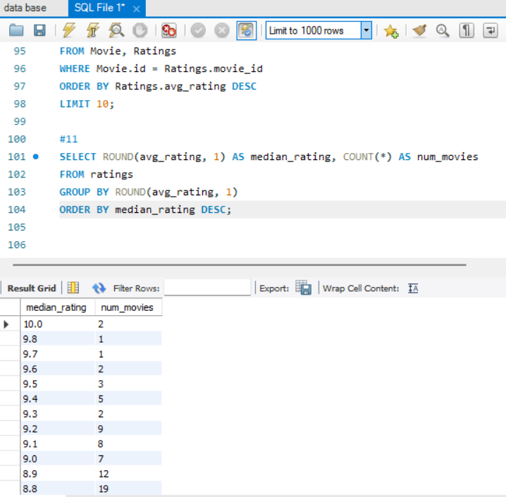
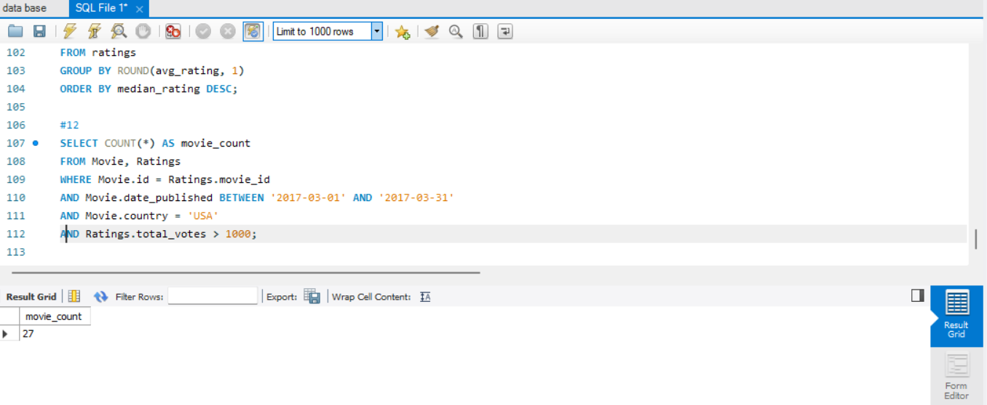
11. Summarize the ratings table by grouping movies based on their median ratings. 12. How many movies, released in March 2017 in the USA within a specific genre, had more than 1,000 votes?

Slide 10
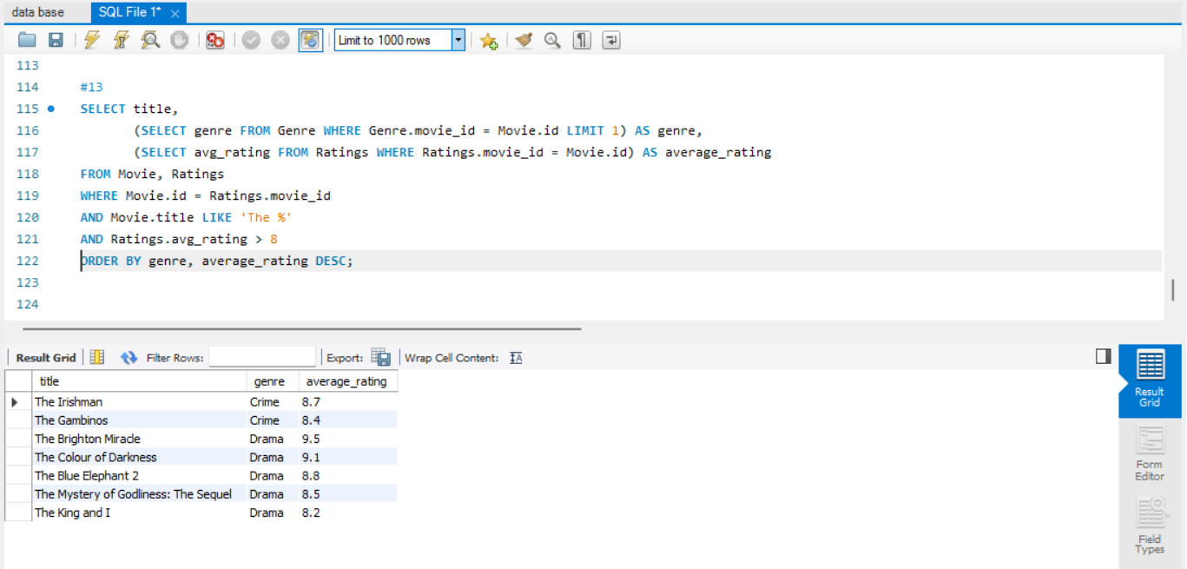
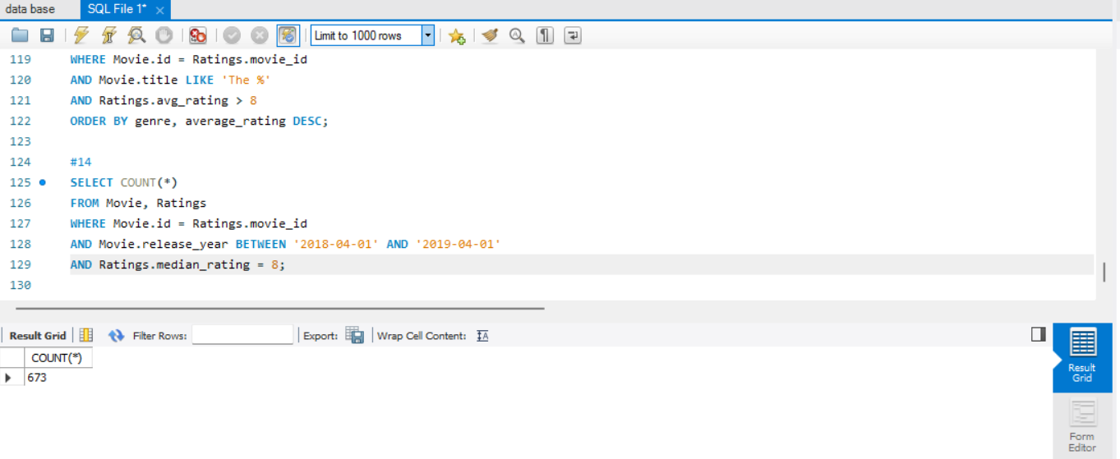
13. Find movies from each genre that begin with the word “The” and have an average rating greater than 8. 14. Of the movies released between April 1, 2018, and April 1, 2019, how many received a median rating of 8?

Slide 11
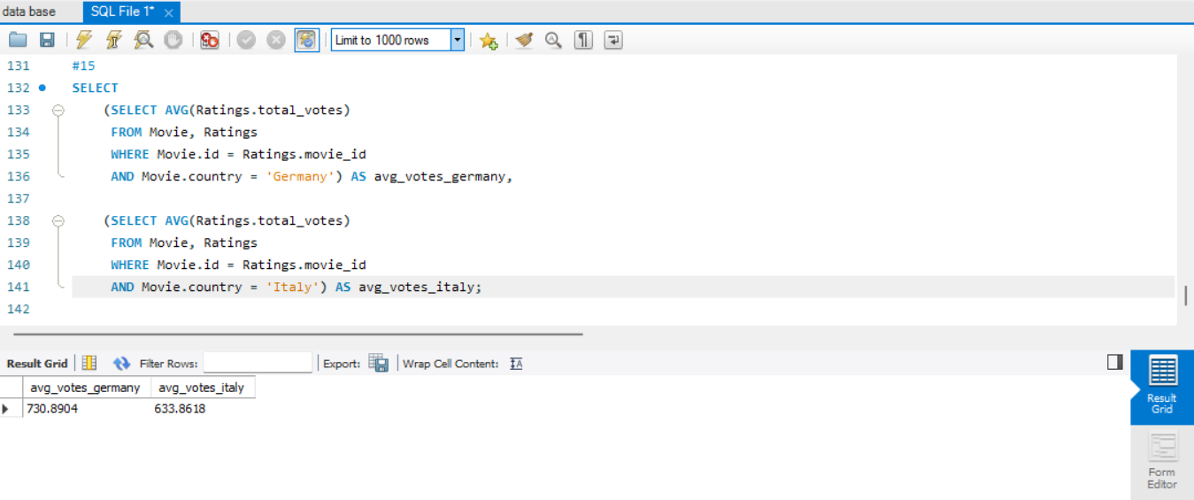
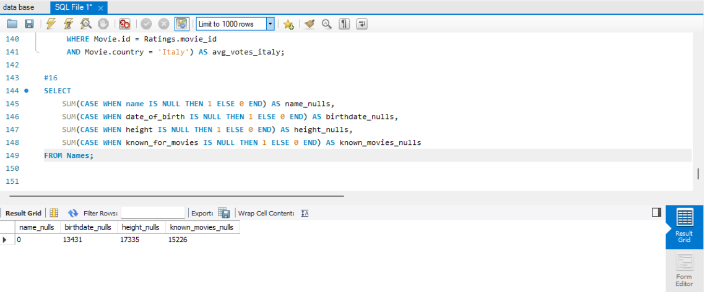
15. Do German movies receive more votes on average than Italian movies? 16. Identify the columns in the names table that contain null values.

Slide 12
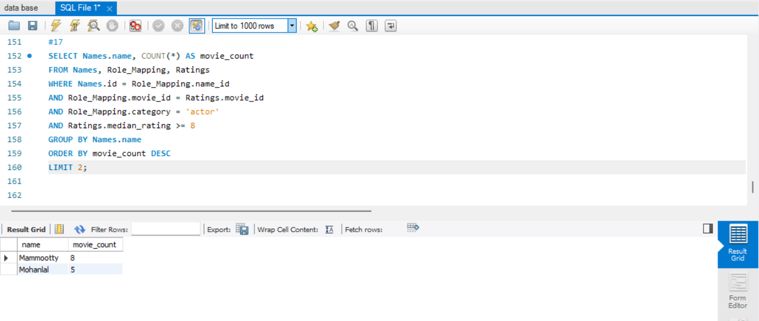
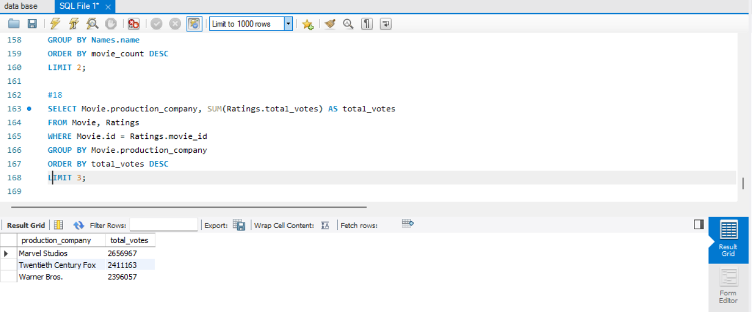
17. Who are the top two actors whose movies have a median rating of 8 or higher? 18. Which are the top three production companies based on the total number of votes their movies received?

Slide 13
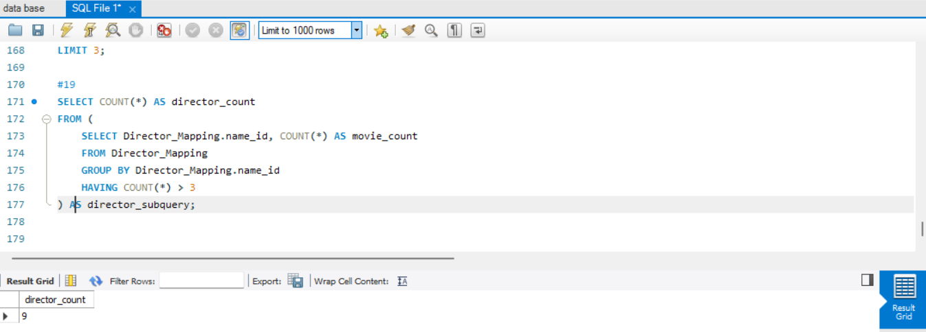
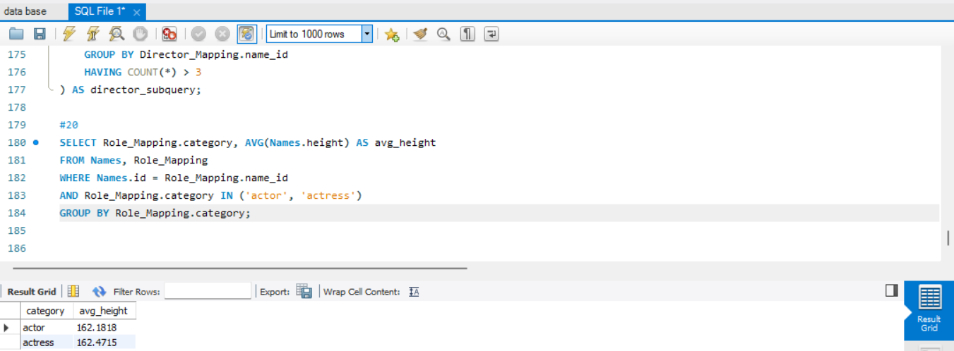
19. How many directors have worked on more than three movies? 20. Calculate the average height of actors and actresses separately.

Slide 14
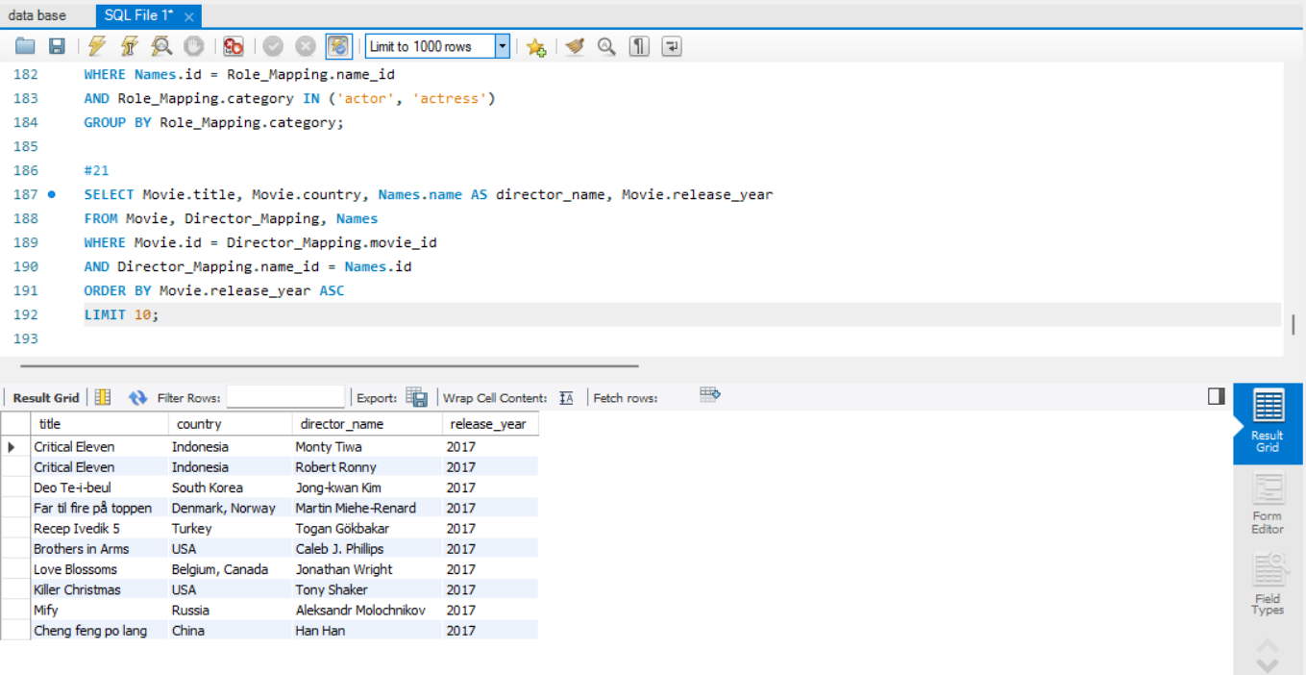
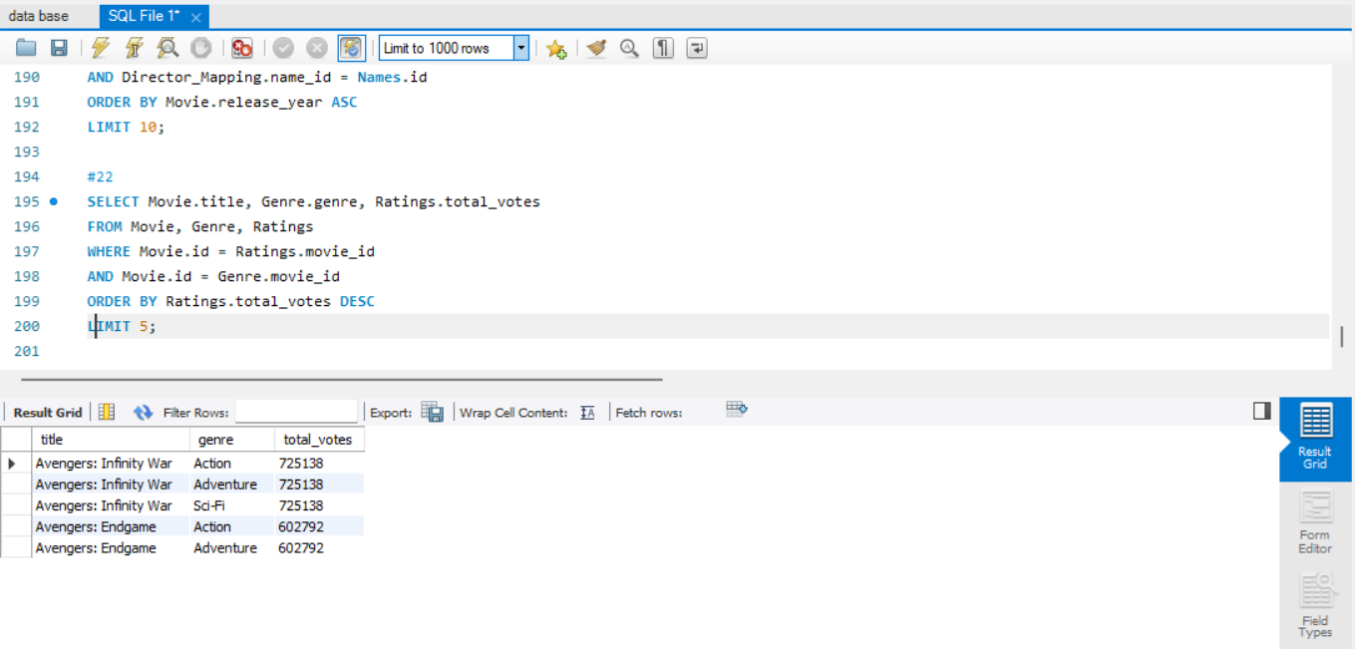
21. List the 10 oldest movies in the dataset along with their title, country, and director. 22. List the top 5 movies with the highest total votes, along with their genres.

Slide 15
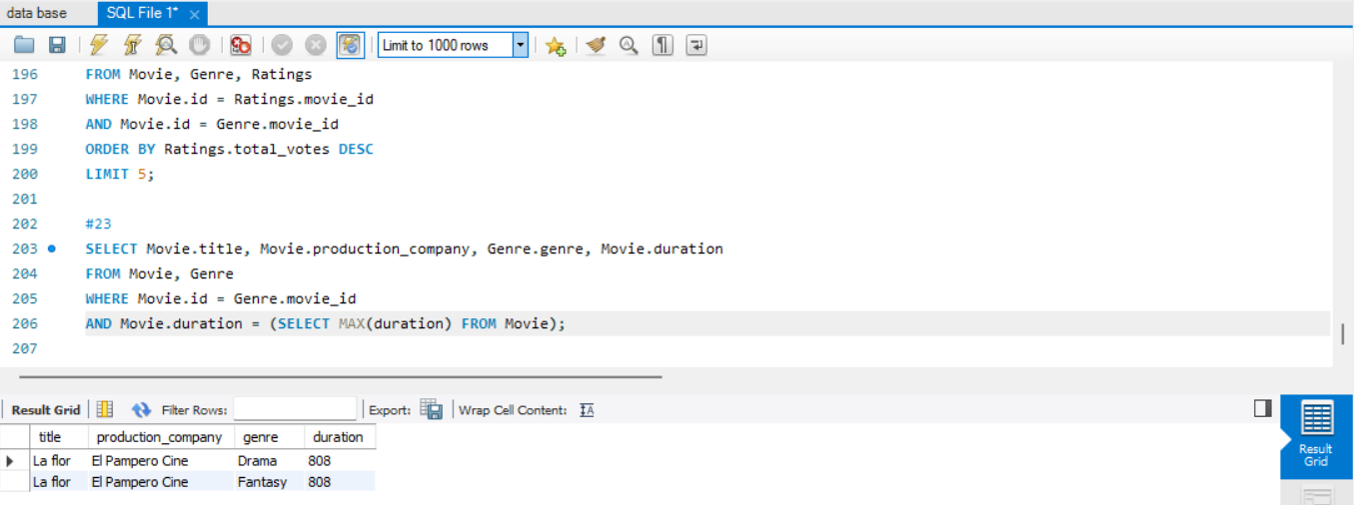
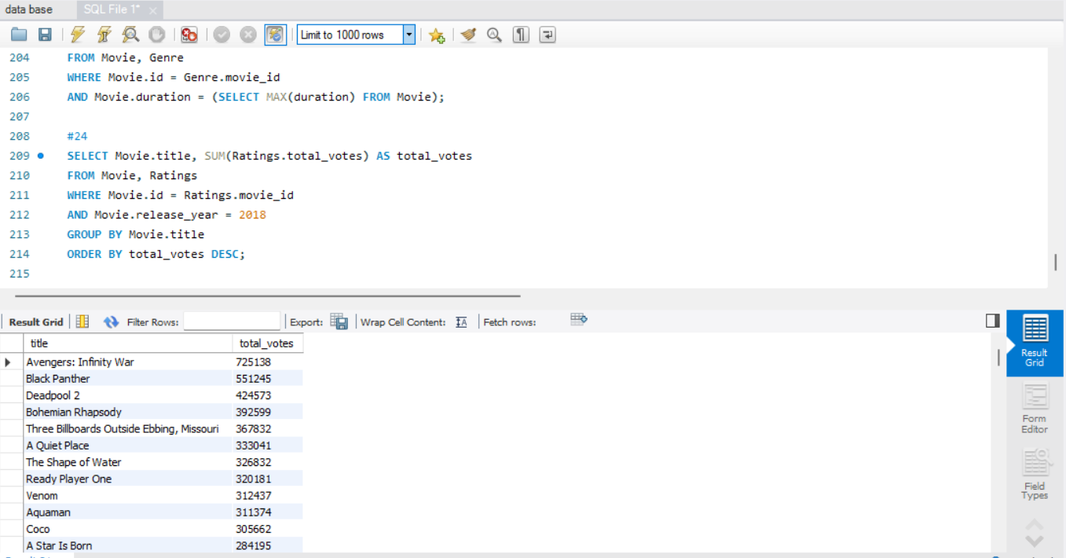
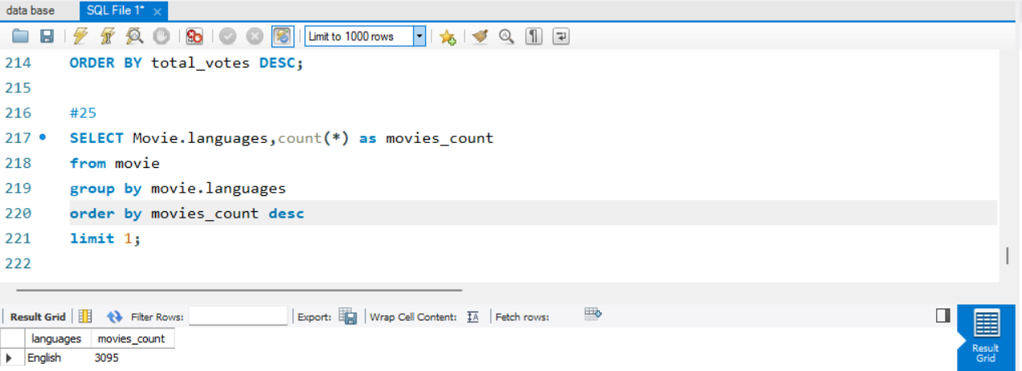
23. Identify the movie with the longest duration, along with its genre and production company. 24. Determine the total number of votes for each movie released in 2018. 25. What is the most common language in which movies were produced?

Slide 16


